Slide 1
Analysis of LinkedIn Company & Influencers Data
Gabriel Amodeo Elbing, Leah Healy, Frank McGurkin, Thomas Mercurio, Matthew Zilligen, Meng Chen, Kristina White, Kai Zhang

Slide 2
Company Data
Contains information about the company:
Number of followers
Number of connections
Contains information about LinkedIn Company pages posts:
Content of the post
Number of hashtags used
Number of reactions
Number of comments
Notes:
Gabriel

Slide 3
Influencers Data
Contains information about the influencer:
Number of followers
Number of connections
Contains information about LinkedIn Influencers’ posts:
Content of the post
Number of hashtags used
Number of reactions
Number of comments
Notes:
Gabriel

Slide 4
Popularity Metric
A metric that is a weighted average of reactions and comments was created for both datasets
This metric is used as a proxy for the popularity of each post
Notes:
Gabriel

Slide 5
EDA

Slide 6
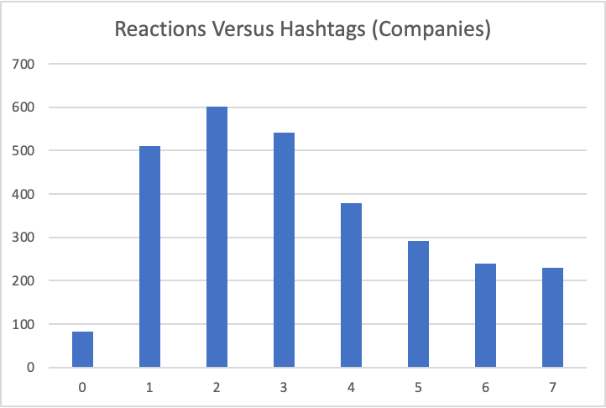
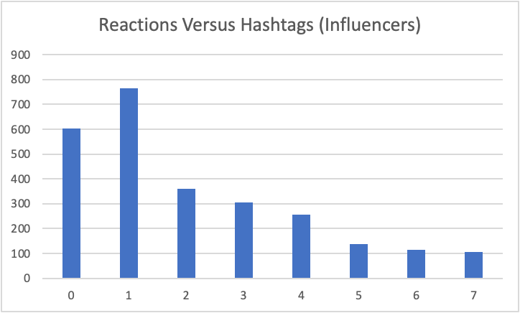
Number of Hashtags Between Datasets
Notes:
Thomas

Slide 7
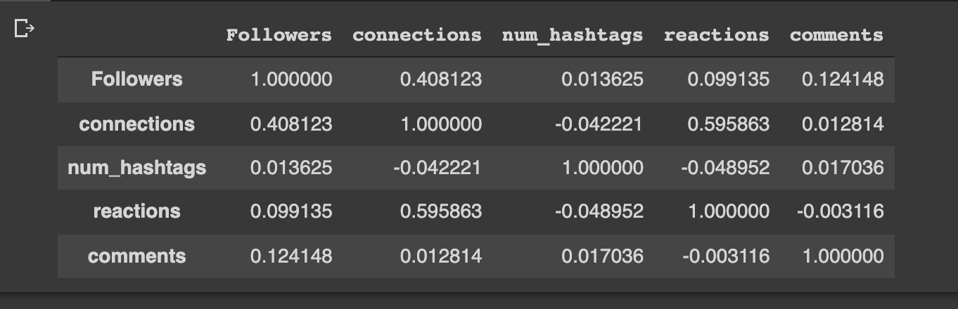
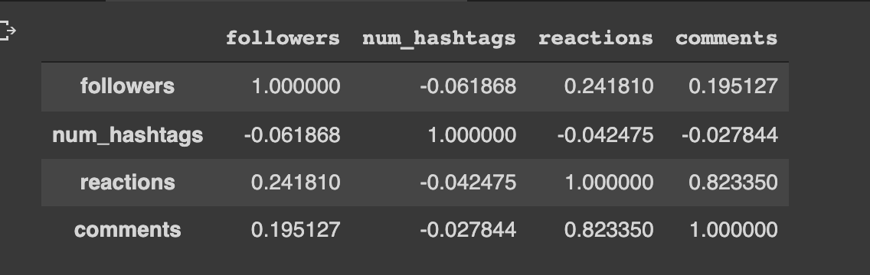
Comparing Correlations Between Datasets
Companies
Influencers
Notes:
Thomas

Slide 8
Comparing Types of Posts Between Datasets
Companies | Followers | Reactions | Comments | Reac./1000 Followers | Comm./1000 Followers | Count
Video | 2,316,509.09 | 505.26 | 22.44 | 0.218 | 0.0097 | 3,327
Image | 2,379,536.37 | 477.61 | 15.18 | 0.201 | 0.0064 | 3,821
Article | 1,668,768.24 | 524.69 | 9.37 | 0.314 | 0.0056 | 13,540
Influencers
Video | 1,672,869.94 | 865.67 | 69.79 | 0.518 | 0.0417 | 2,690
Image | 1,699,088.89 | 824.35 | 39.73 | 0.485 | 0.0234 | 8,708
Article | 894,664.07 | 160.65 | 10.07 | 0.180 | 0.0113 | 15,144
Notes:
Thomas

Slide 9
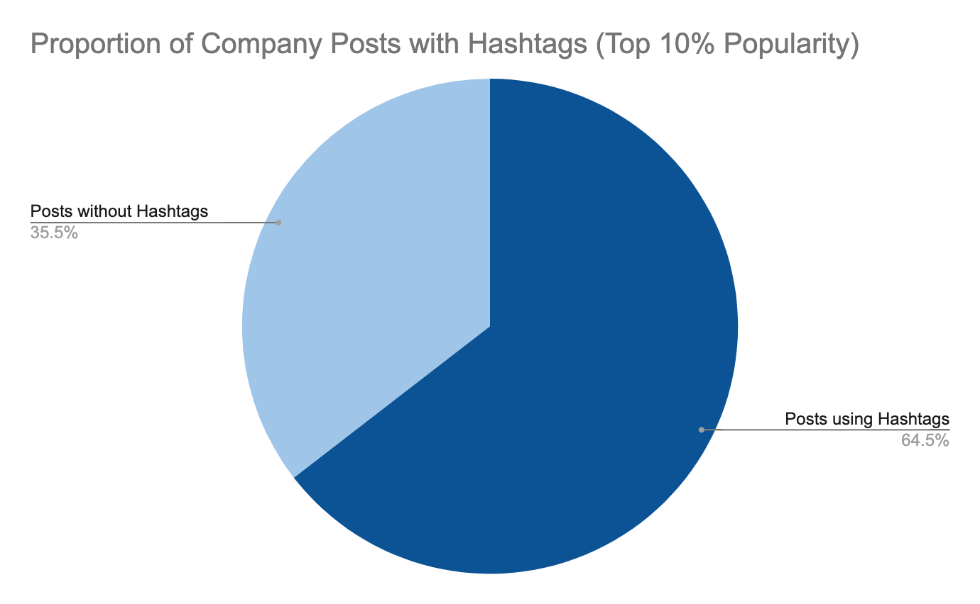
Hashtag Analysis: Company Data
Popularity Cutoff (10%):
418.333
1167 posts above cutoff
Mean number of hashtags: 1.76
Notes:
Frank

Slide 10


Company Hashtag Frequencies (Top 10% Popularity)
Hashtag |  | Frequency |  | Relative Frequency
#BMWGroup |  | 113 |  | 0.0968
#COVID19 |  | 83 |  | 0.0711
#UniquelyUnilever |  | 68 |  | 0.0583
#ElectrifYou |  | 46 |  | 0.0394
#ITC |  | 36 |  | 0.0308
#automotive |  | 30 |  | 0.0257
#PfizerProud |  | 25 |  | 0.0214
#BMW |  | 23 |  | 0.0197
#iAmCaterpillar |  | 21 |  | 0.0180
#Coronavirus |  | 20 |  | 0.0171
Hashtags specific to certain companies:
#BMWGroup, #BMW
#UniquelyUnilever
Notes:
Frank

Slide 11
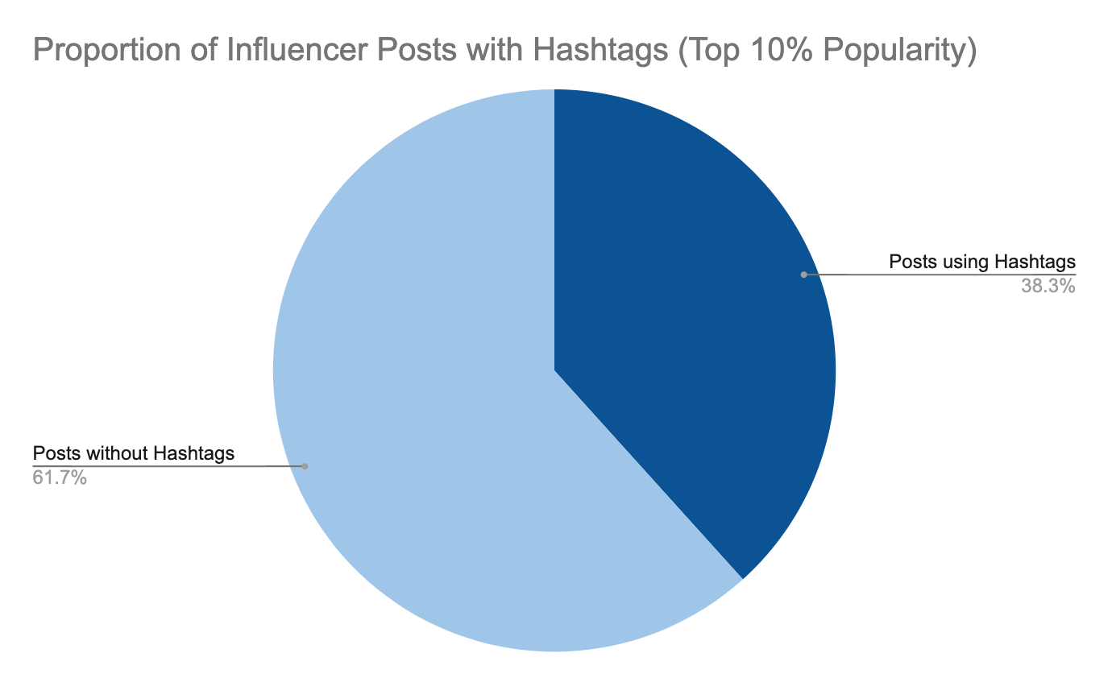
Hashtag Analysis: Influencer Data
Popularity Cutoff (10%):
200.667
3398 posts above cutoff
Mean number of hashtags: 1.06
Notes:
Frank

Slide 12

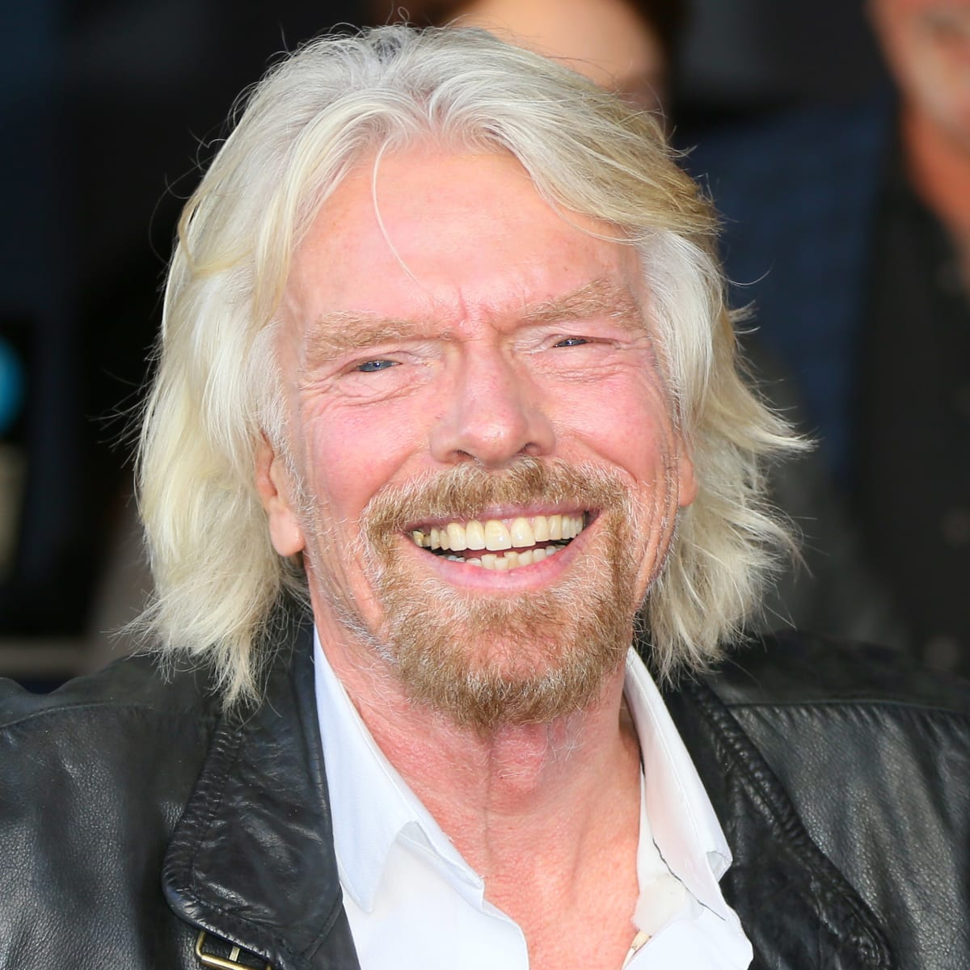
Influencer Hashtag Frequencies (Top 10% Popularity)
Hashtag |  | Frequency |  | Relative Frequency
#justQ |  | 157 |  | 0.0462
#entrepreneurship |  | 91 |  | 0.0268
#VirginFamily |  | 86 |  | 0.0253
#business |  | 60 |  | 0.0177
#ReadByRichard |  | 52 |  | 0.0153
#leadership |  | 50 |  | 0.0147
#WeekendMusings |  | 48 |  | 0.0141
#economy |  | 42 |  | 0.0124
#India |  | 42 |  | 0.0124
#markets |  | 42 |  | 0.0124
Hashtags specific to certain influencers:
#justQ
#VirginFamily, #ReadByRichard
Quentin Allums
Marketing Lead and Speaker
Richard Branson
Founder of the Virgin Group
Notes:
Frank

Slide 13
Key Takeaways
Low relative frequency, brand-specific hashtags show that there are not specific hashtags among popular posts that attract activity
Specific brand and content are like drivers of high activity, not use of certain hashtags
Notes:
Frank

Slide 14
Modeling

Slide 15
Goals
Goal is to accurately measure popularity through LinkedIn
Continuous, quantitative y-variable using various predictors in data set
Measure popularity based on comments and reactions
Assigned weights
Weight of comments: ⅔
Weight of reactions: ⅓
Assigned greater weight to the comments due to extra effort it takes to write a comment
Popularity does not distinguish between positive and negative interactions
Only using the company data
Notes:
Matthew Zilligen

Slide 16
Preprocessing
Filtered out all rows with time less than one day
Note: May create minimal bias
Change all quantitative data from strings to floats
Remove commas in large numbers
Drop unnecessary columns
Location, media_type, about, media_urls, hashtags, etc.
Split data into training and testing sets
Notes:
Matthew Zilligen

Slide 17
Preliminary Model
Original Model: Decision tree regressor
Predictors: followers, connections, number of hashtags
R²: 0.2257747647065554
MSE: 203874.616921866
Notes:
Matthew Zilligen

Slide 18
Preliminary Model
Second Model: Random Forest
Predictors: followers, connections, number of hashtags
MSE: 205996.68259815138
Notes:
Leah
Mean Squared Error right around the decision tree regressor
Random forest is a supervised learning algorithm. The "forest" it builds, is an ensemble of decision trees, usually trained with the “bagging” method. The general idea of the bagging method is that a combination of learning models increases the overall result.
Put simply: random forest builds multiple decision trees and merges them together to get a more accurate and stable prediction.
One big advantage of random forest is that it can be used for both classification and regression problems, which form the majority of current machine learning systems.

Slide 19
Preliminary Model
Second Model: Linear Model
Predictors: followers, connections, number of hashtags
R²: 0.012472456696375881
MSE: 103468.70309077845
Notes:
Leah
Low correlation for the R^2
MSE is lower

Slide 20
Key Takeaways
Followers, connections, number of hashtags did not seem to be strong predictors of popularity by themselves
The content of the post may be more useful in predicting popularity
Notes:
Kristina

Slide 21
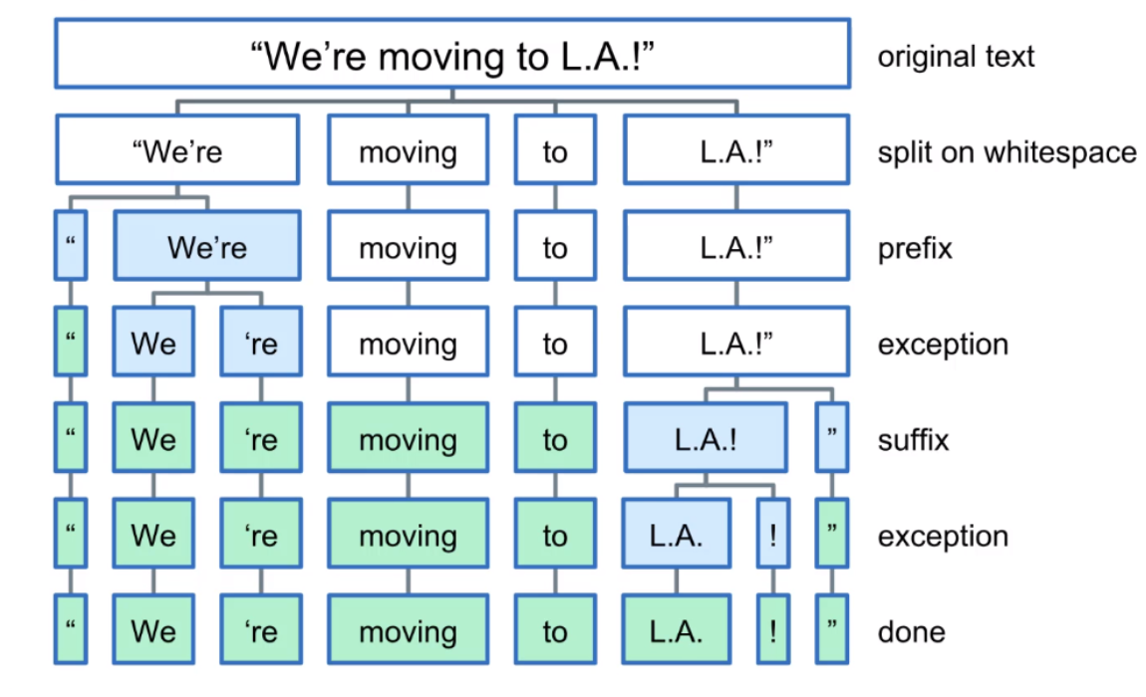
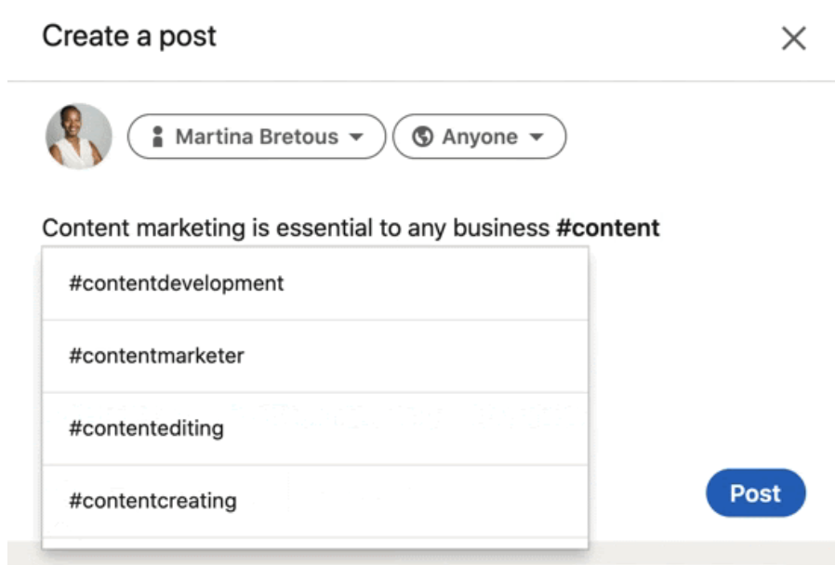
Further Steps
Including the content of the post in the model
We are working on pre-processing the content
Lowercasing
Removing punctuation
Removing stopwords
Tokenizing
Considering hashtags
Notes:
Meng

Slide 22
Benefits
Why is understanding how to predict the popularity of a post important?
Social media would be able to better make recommendations to companies looking to grow their platform about what type of posts users tend to interact with
Improve the user experience for companies
Help companies produce content to reach other uses and that other users are interested in
Notes:
Meng

Slide 23
Questions?
Notes:
Kristina

